Slide 1

Thera Bank

Slide 2



Problem:
Some statement about the metric?
Who are our clients?
This involves identifying the different groups of our customers
Which people will accept a personal loan offer?
This involves predicting the individuals who are more likely to accept a personal loan
How do we target these clients at the lowest possible cost?
Which model reduces the overall amount spent but still achieves desirable results.

Slide 3
What does our data look like?

Slide 4

Data Exploration
The data exploration can be found in the html file attached in the report.
Modeling Considerations
We have replaced the experience years with negative values and replaced them with NA’s.
The missing values for family number and the experience years are imputed using recipes step bag imputation method.
The other columns are normalized
We clean the names in the dataframe as working with bad names makes coding tedious
From the exploration we can see that the age in years and the experience are highly correlated with a correlation coefficient of 0.99 so they basically say the same thing and we can drop either one.
We choose to use the age in years as a variable.

Slide 5
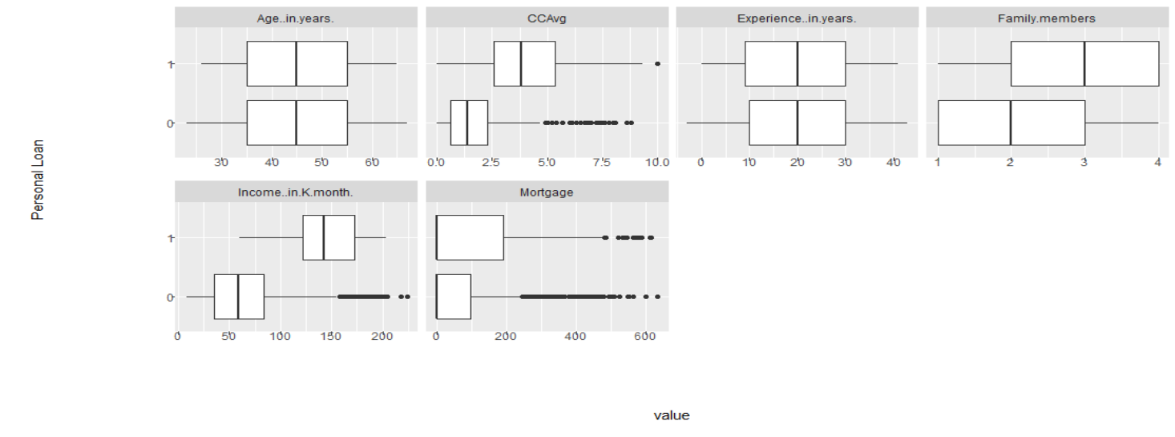

Slide 6
Who are our customers

Slide 7
Who are our customers
To identify customer groups we undertake clustering on the data
Modeling Considerations
For interpretability of the clusters we choose a number of clusters between 2 and 8.
We use hierarchical clustering on the data as it is a chosen method that works with the distance matrix chosen
The silhouette plot is shown on the next page
Scaled the continuous variables since the data are on different scales
Variables with near zero variance after scaling and centering were removed (i.e. the mortgage)
Used Gower distance matrix as the data is of a mixed type and Euclidian distance doesn’t make sense for continuous data
Personal Loan, Securities Account, CD Account, Online and Credit card are asymmetric binary and must be treated as such
Converted Family members into a factor variable as it is not continuous, i.e. you cannot have 1.3 family members.

Slide 8
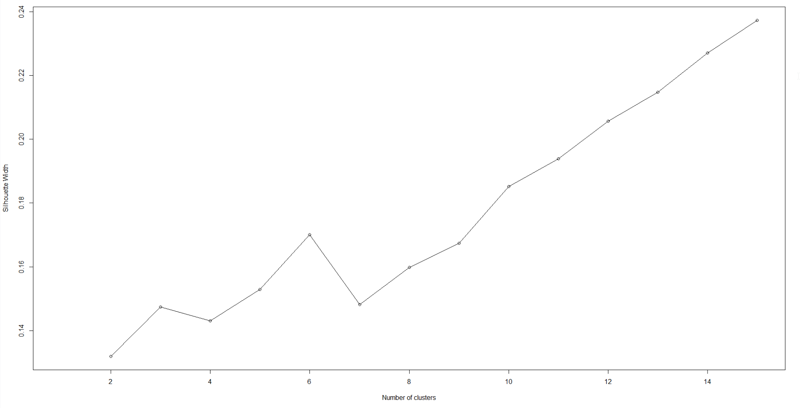

Results of clustering algorithm
Quick Insights
The optimal number of clusters to choose is 6
The silhouette width value is low, and improvements can be made to the clustering algorithm (e.g. grouping the variables into bands)
The zip code is dropped as a variable as the are 467 different states in data of 5000

Slide 9
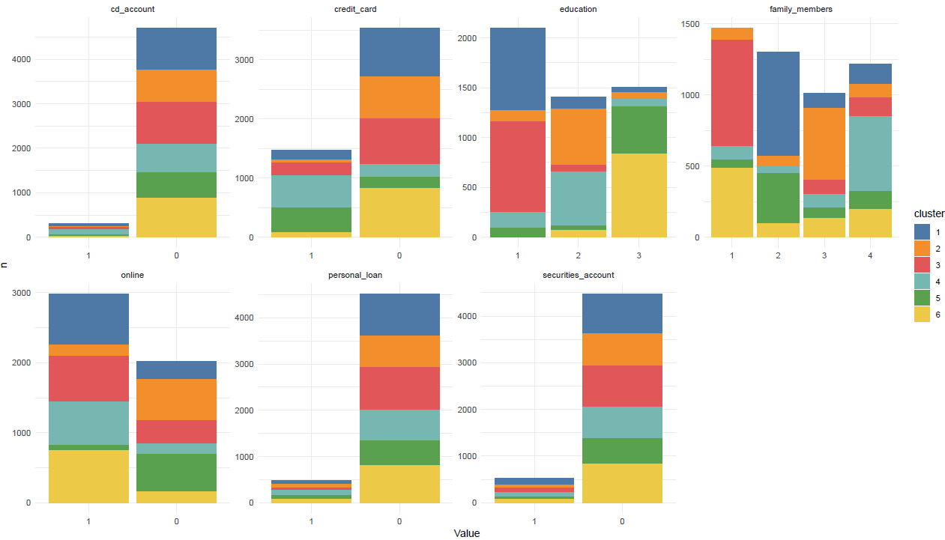
Results of clustering algorithm
Quick Insights
The best factor variables to describe the different clusters with are the number of family members, the level of education, online and whether they have a credit card or not.
The clustering would most likely improve if we removed the cd account, personal loan and the securities account variables

Slide 10
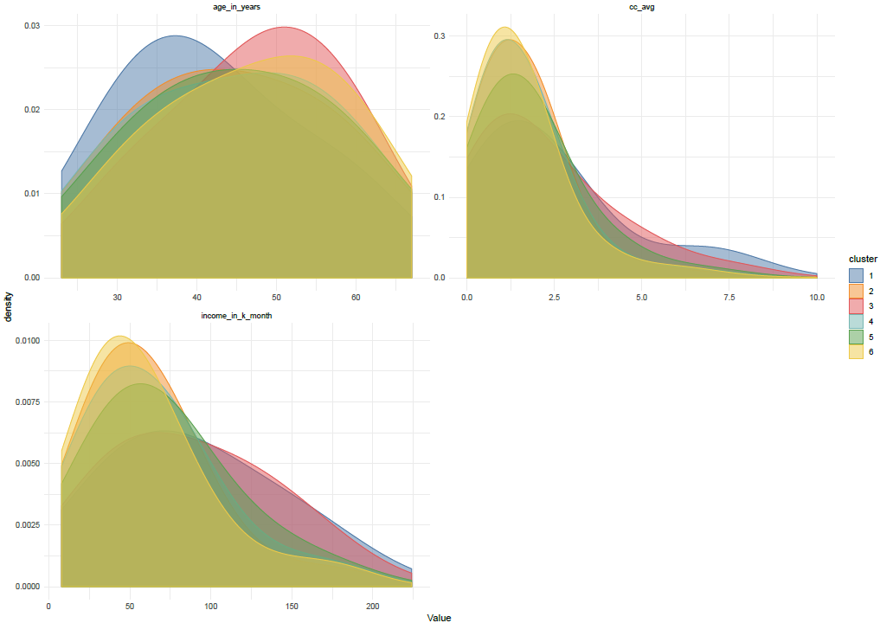
Results of clustering algorithm
Quick Insights
The best continuous variables to explain the clusters are the age in years and the income in thousands per month.

Slide 11
Results of clustering algorithm
Cluster | 1 | 2 | 3 | 4 | 5 | 6
Education | Mostly Undergrad | Mostly graduates | Mostly Undergrads | Mostly graduates | Mostly advanced/Professionals | Mostly advanced/Professionals
Family Members | Mostly two members | Mostly 3 members | Mostly 1 member | Mostly 4 members | Mostly two members | Mostly one member
Online | Mostly online | Mostly No online | Mostly online | Mostly online | Mostly No online | Mostly online
Credit card | Mostly No credit card | Mostly No credit card | Mostly No credit card | Mostly credit card | Mostly credit card | Mostly No credit card
Age | Mean age below 40 | Mean age below 45 | Mean age above 50 |  | Mean age below 45 | Mean age above 50
Income | 1 | 5 | 1 | 4 | 3 | 6

Slide 12
Building the model

Slide 13

Variable Selection
Approach:-
We are trying to predict whether a person accepts a personal loan, so we look at the distribution of individuals who have accepted and denied personal loans across the various variables as shown in the graphs in the next two pages.
We use the Boruta package to verify our variable assumptions and find any other variables that have no bearing on the personal loan.
Variable Assumptions
The zip code would not be important in determining the personal loans as the data shows that there are 467 unique states in data with 5000 individuals and there is no clear pattern in the bar plot of zip code colored by whether an individual accepts a personal loan or not
It also goes to reason that the zip code should not have much bearing on personal loan acceptance
The cluster was also added as a variable and was found to have predictive power
Model Selection Using Boruta
The same data transformed and used for the clustering was used in building the model
The Boruta package found that only the zip code was the inconsequential variable and the model output has been attached on the next page
Our assumption has been proven correct
*The Boruta package only works with complete data and can be slow for very large datasets but the data within this case is not large enough to create runtime issues and imputation has been run on the data.

Slide 14
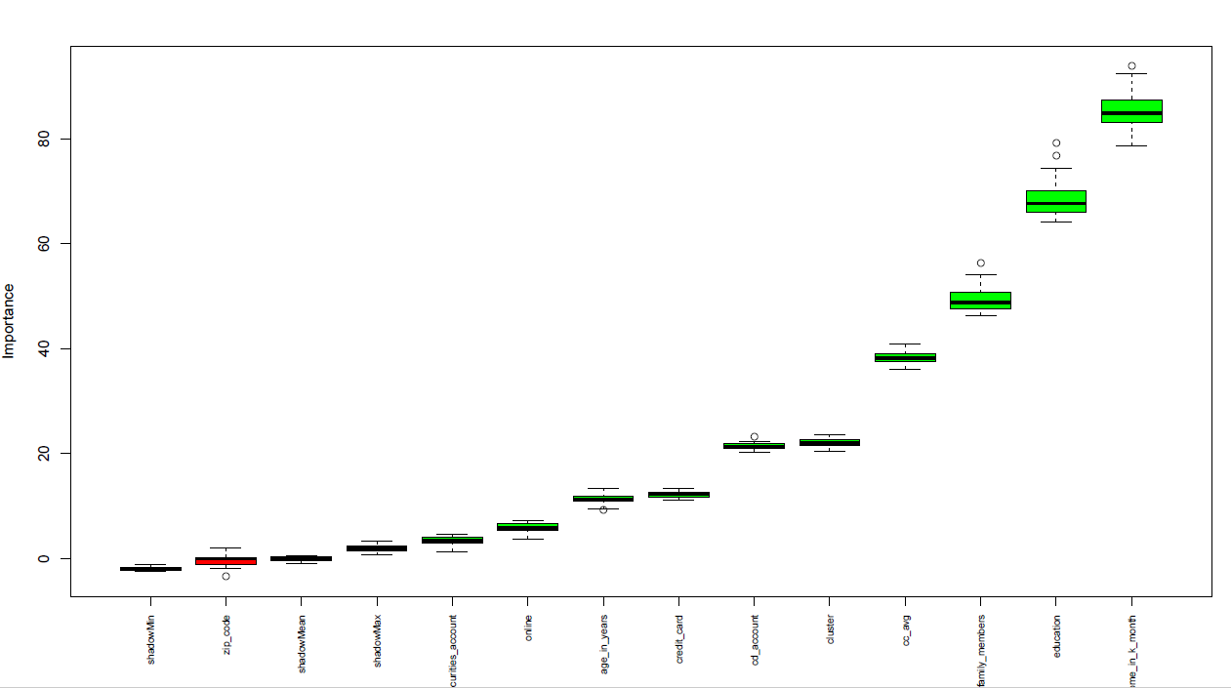
Boruta output
Quick Insights
The zip code is not an important variable

Slide 15
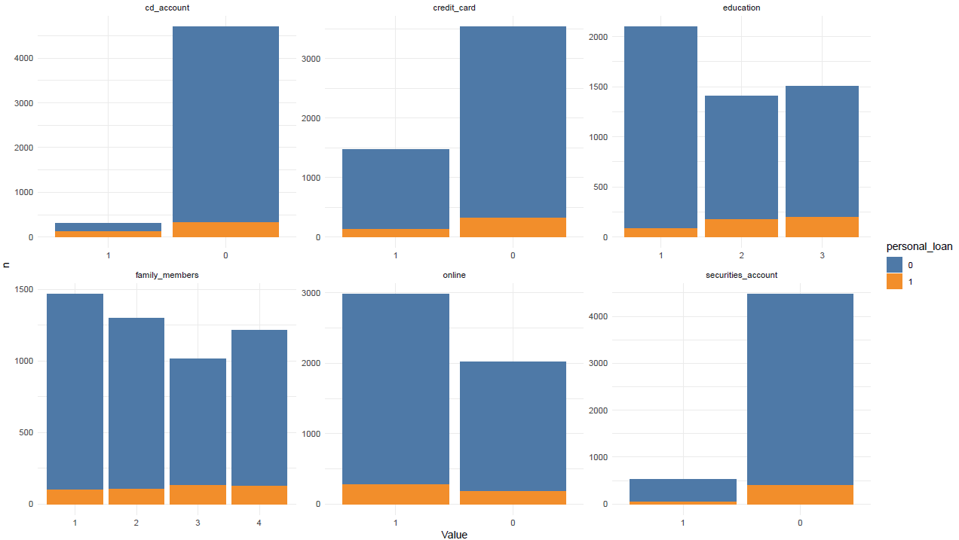

Slide 16
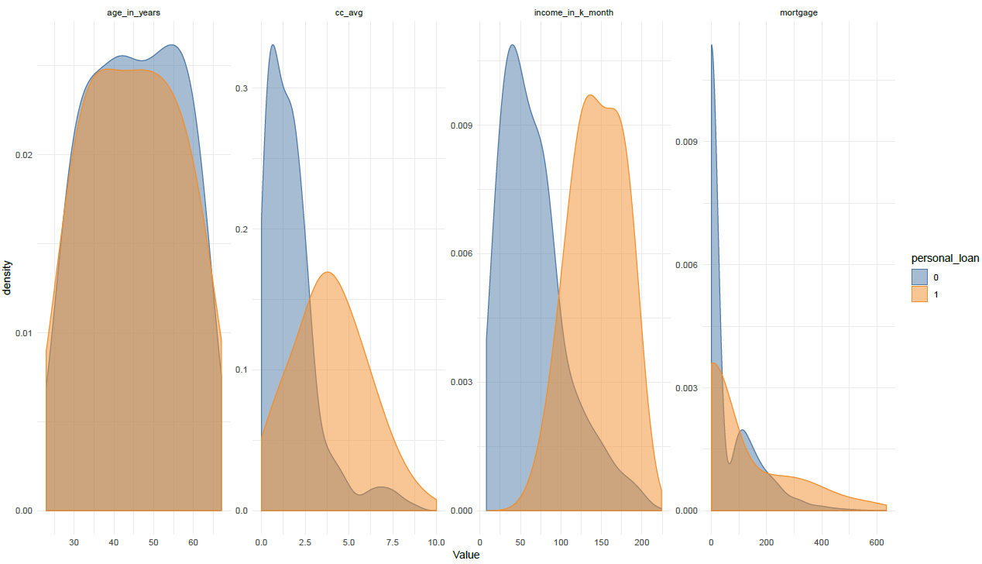
Quick Insights
The income in thousands per month is expected to be the most important numerical variable followed by the cc average
The mortgage variable has no clear distinction with a lot of individuals having no mortgage. Options are to convert it to factor but it was dropped for having a near zero variance (there could be an opportunity to turn it into a factor if the model accuracy is not satisfactory enough)
The age is expected to have some bearing on the prediction of who accepts a personal loan but not too much

Slide 17
Building the model

Slide 18
Picking the right model
We build two models
CART
From rpart package (+) Efficient to train (+) Easy to understand and interpret (-) relatively unstable
Random Forest
Random Forest (+) Robust (-) Black box (-) Takes longer to train

Slide 19
CART Model

Slide 20
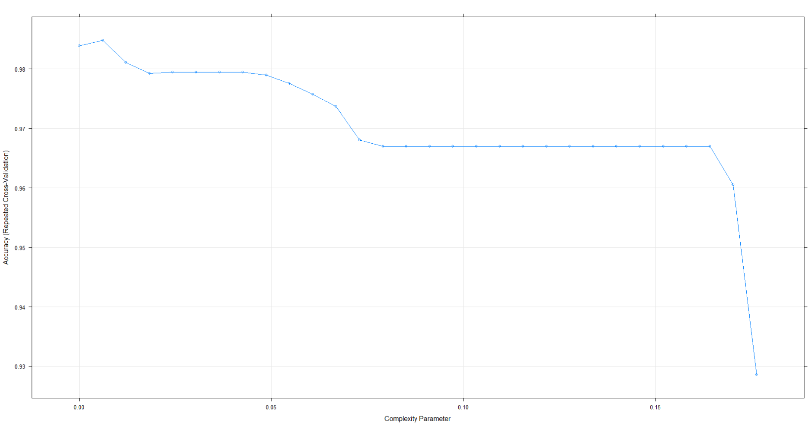
0.0080085
Training results
Quick Insights
Most accurate model is found at complexity 0.00608
The model is trained using the caret and starts off with the caret package which shows that the most ideal place to prune is at a cp value of 0.00608
Table showing top 5 models
cp | accuracy | kappa
0.00608 | 0.9848 | 0.91006
0.0000 | 0.9839 | 0.90458
0.0126 | 0.9811 | 0.88451
0.0182 | 0.9792 | 0.87024
0.00608

Slide 21
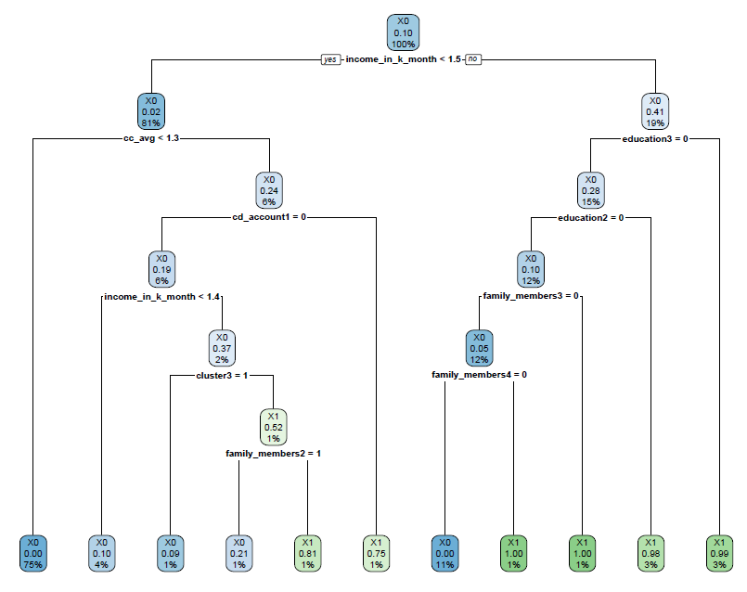
0.0080085
Pruned Tree
Quick Insights
The flow down the tree is how it makes decisions.
For example if the income is less than 1.5 and the cc average is less than 1.3 then the individual has a probability of 0.75 of not accepting the personal loan.

Slide 22
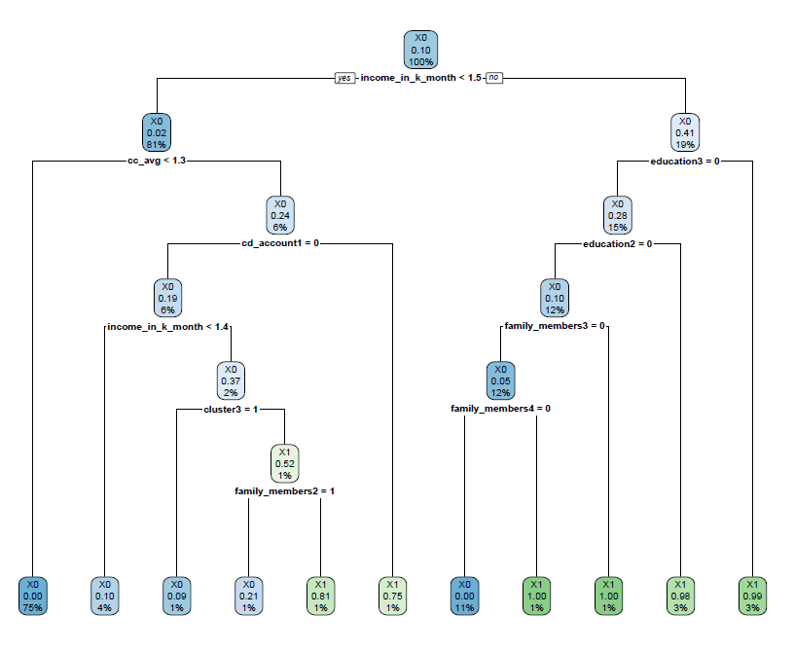
0.0080085
Pruned Tree
Quick Insights
The pruned and unpruned tree are the same
The model is quite accurate with an overall error rate of 1.2%
The error in predicting that someone is going to accept the personal loan and they do not is 0.88%
The error in predicting that someone will accept the loan and they do not is 2%
Reference
 | X0 | X1 | Error | Error%
X0 | 450 | 5 | 5/455 | 0.88%
X1 | 1 | 44 | 1/45 | 2%
Total | 451 | 49 | 6/500 | 1.2%
Prediction

Slide 23
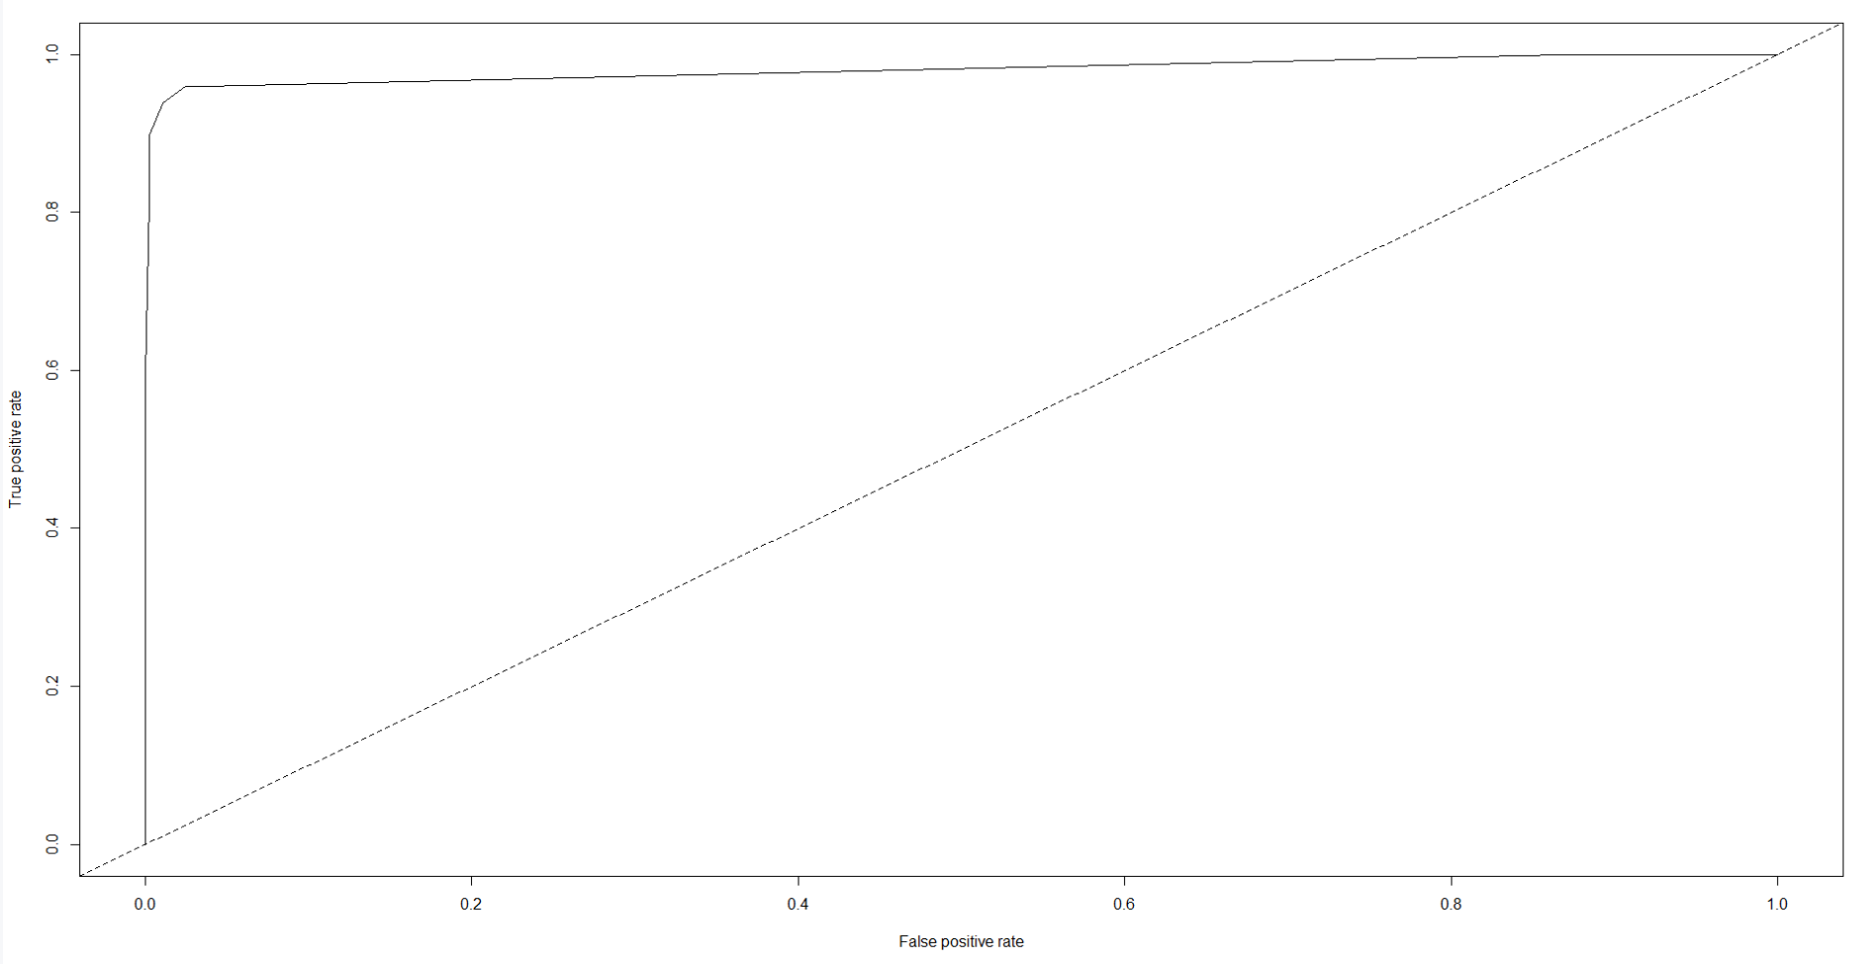
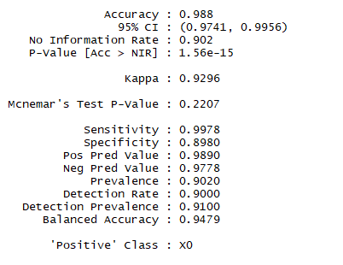
0.0080085
Training results
Quick Insights
The model is quite accurate with an overall error rate of 1.2%
Other model metrics

Slide 24
Random Forest Model

Slide 25
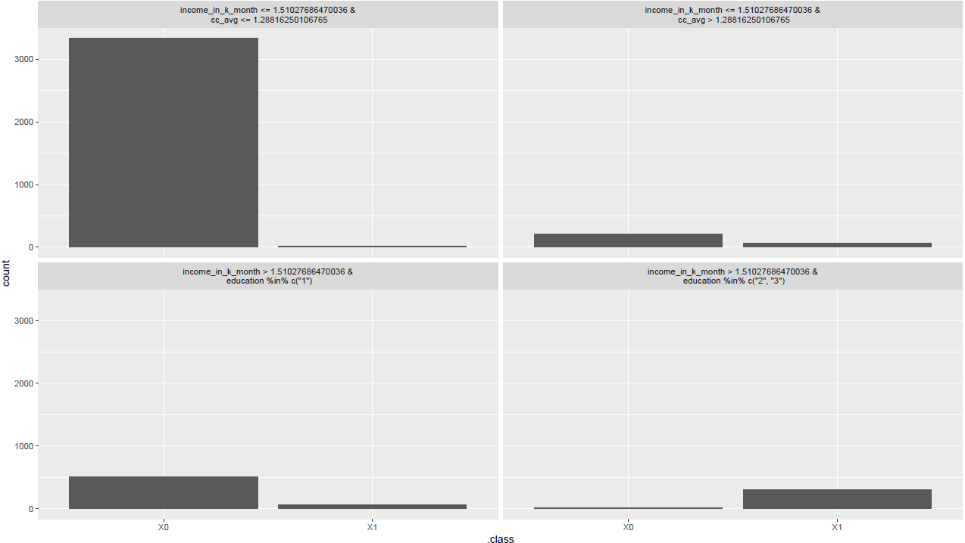
Plotting the tree/How it makes decisions
Quick Insights
Based on the feature importance, only 2 features matter so we set the depth on the simple tree to 3 to show how decision are made
The combination shows that most of the time when the income is less than 1.5K and the cc average is les than 1.2 then the person is more likely than not to not accept the personal loan.
0.00608

Slide 26
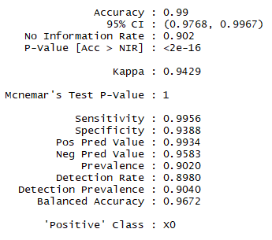
0.0080085
Training results
Quick Insights
The model is quite accurate with an overall error rate of 1%
The error in predicting that someone is going to accept the personal loan and they do not is 0.66%
The error in predicting that someone will accept the loan and they do not is 4%
Reference
 | X0 | X1 | Error | Error%
X0 | 448 | 3 | 3/451 | 0.67%
X1 | 2 | 47 | 2/49 | 4%
Total | 450 | 50 | 5/500 | 1%
Prediction

Slide 27
Compare the Models

Slide 28
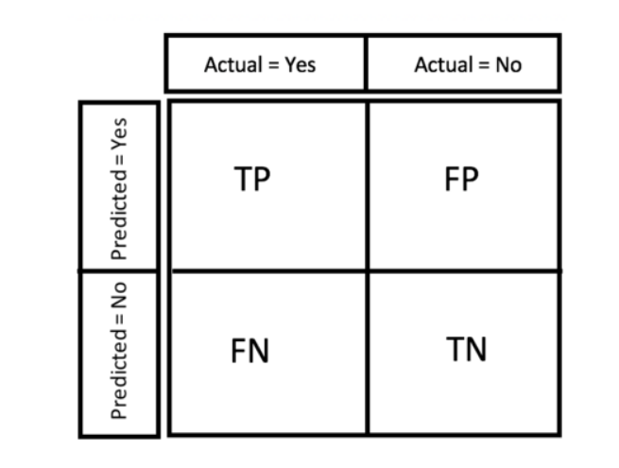
Analyzing the results
Confusion Matrix
Metric Considerations
The point of the model is to make the most efficient use of the marketing budget
This means that we want to minimize the number of people we wrongly predict to accept the loan (false positives) and reduce the false negatives as well (i.e. people we predict to not have accepted the loan when they have)
Because of the highly imbalance nature of the data and the fact that there are more people who deny the personal loans, we need to choose the model that has the lowest false positive rate.
AUCPR/f2 score would be the best metrics to use for the different models

Slide 29
Comparing results
RPart
Random Forest
Reference
Reference
 | X0 | X1 | Error | Error%
X0 | 450 | 5 | 5/455 | 0.88%
X1 | 1 | 44 | 1/45 | 2%
Total | 451 | 49 | 6/500 | 1.2%
 | X0 | X1 | Error | Error%
X0 | 448 | 3 | 3/451 | 0.67%
X1 | 2 | 47 | 2/49 | 4%
Total | 450 | 50 | 5/500 | 1%
Quick Insights
Prediction
Prediction
We choose the Random forest model as it has a lower false positive score
The random forest therefore lowers the total marketing cost and achieves the desired result
AUC = 0.9805
AUC = 0.9985

Slide 30
Conclusion

Slide 31
Conclusion
We choose the random forest model

